Slide 1
IMAGE CLASSIFICATION : CLASSIFY IMAGES OF CLOTHING
NAAN MUDHALVAN
GENERATIVE AI FOR ENGINEERING (E2324)
SHRUTHI N- 2021503556 DEPARTMENT OF COMPUTER TECHNOLOGY
MADRAS INSTITUTE OF TECHNOLOGY

Slide 2
OUTLINE :
Introduction
Problem Statement
Objective
Software Requirements
Proposed Work
Result
Conclusion
References

Slide 3
Introduction:
The Project presents a practical demonstration of image classification using TensorFlow, a powerful deep learning framework.
The entire workflow, from data loading and preprocessing to model training and evaluation.
It describes about visualization tools to interpret model predictions, aiding in understanding its decisions and confidence levels.

Slide 4
Problem Statement:
The problem statement for this demonstration is to accurately classify images of clothing items into predefined categories using machine learning techniques.
The task involves training a neural network model to correctly identify various types of clothing, such as T-shirts, trousers, pullovers, dresses, coats, sandals, shirts, sneakers, bags, and ankle boots, based on input images.
The goal is to develop a robust image classification system capable of accurately distinguishing between different types of clothing items with high accuracy using TensorFlow and the Fashion MNIST dataset.

Slide 5
Objectives
The objective of this demonstration is to provide a step-by-step guide to implementing image classification using TensorFlow.
It aims to showcase the capabilities of TensorFlow in building, training, and evaluating neural network models for image classification tasks.
By using this , we can gain practical experience in preprocessing image data, constructing neural network architectures, optimizing models, and interpreting prediction results.

Slide 6
SOFTWARE REQUIREMENTS:
Language Used: Python
Tool : Google Colab
Libraries used: Tensor Flow, keras, Matplotlib, Pandas, Numpy, Seaborn.

Slide 7
Proposed solution:
Data Collection
Preprocessed Data
Train the model
Verify Predictions

Slide 8
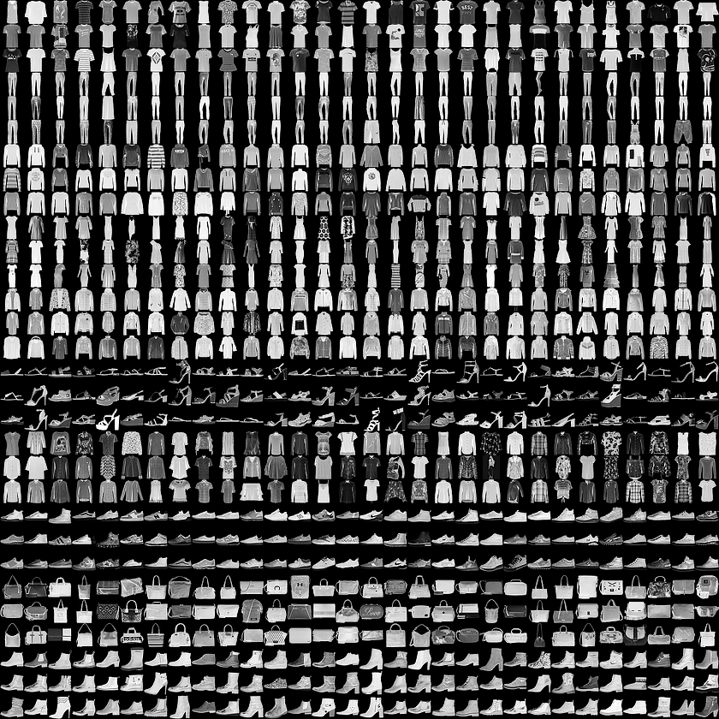
Data Collection
This project uses the Fashion MNIST dataset which contains 70,000 grayscale images in 10 categories. The images show of clothing at low resolution (28 by 28 pixels)
60,000 images are used to train the network and 10,000
images to evaluate how accurately the network learned to
classify images

Slide 9
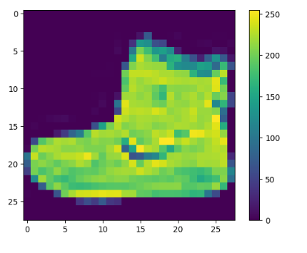
Preprocessed Data
The data must be preprocessed before training the network. If you inspect the first image in the training set, you will see that the pixel values fall in the range of 0 to 255.
Scale these values to a range of 0 to 1 before feeding them to the neural network model. To do so, divide the values by 255.

Slide 10
Train the Model
Training the neural network model requires the following steps:
Feed the training data to the model. In this example, the training data is in the train_images and train_labels arrays.
The model learns to associate images and labels.
You ask the model to make predictions about a test set—in this example, the test_images array.
Verify that the predictions match the labels from the test_labels array.

Slide 11
Verify Predictions
With the model trained, we can make predictions about some images.
Let's look at the 0th image, predictions, and prediction array. Correct prediction labels are blue and incorrect prediction labels are red. The number gives the percentage (out of 100) for the predicted label.
Let's plot several images with their predictions. Note that the model can be wrong even when very confident.

Slide 12
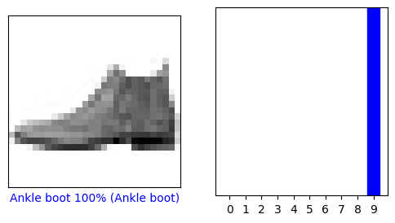
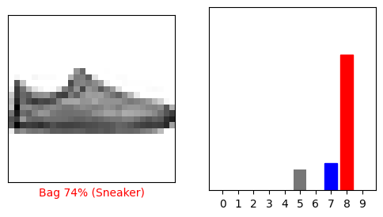
Verify Predictions Contd..

Slide 13
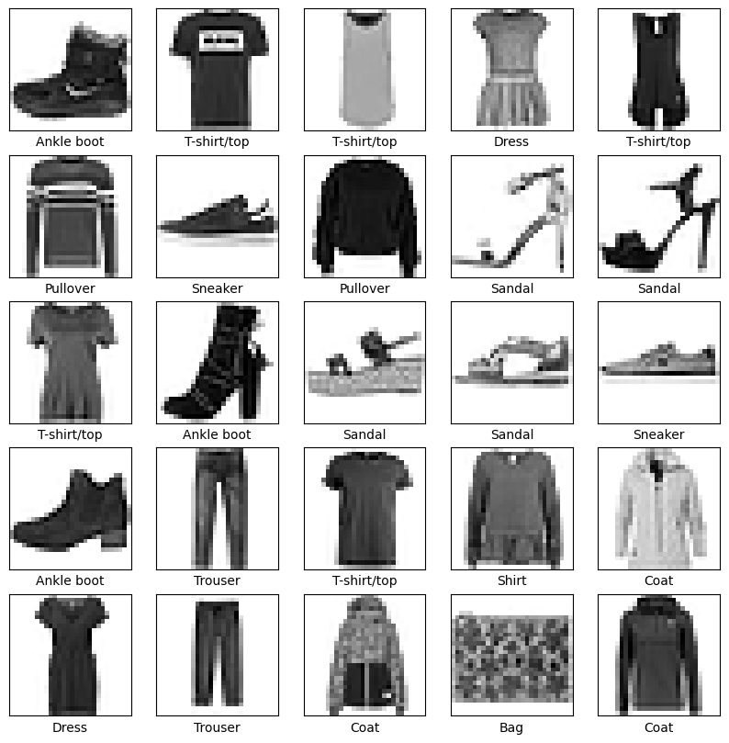
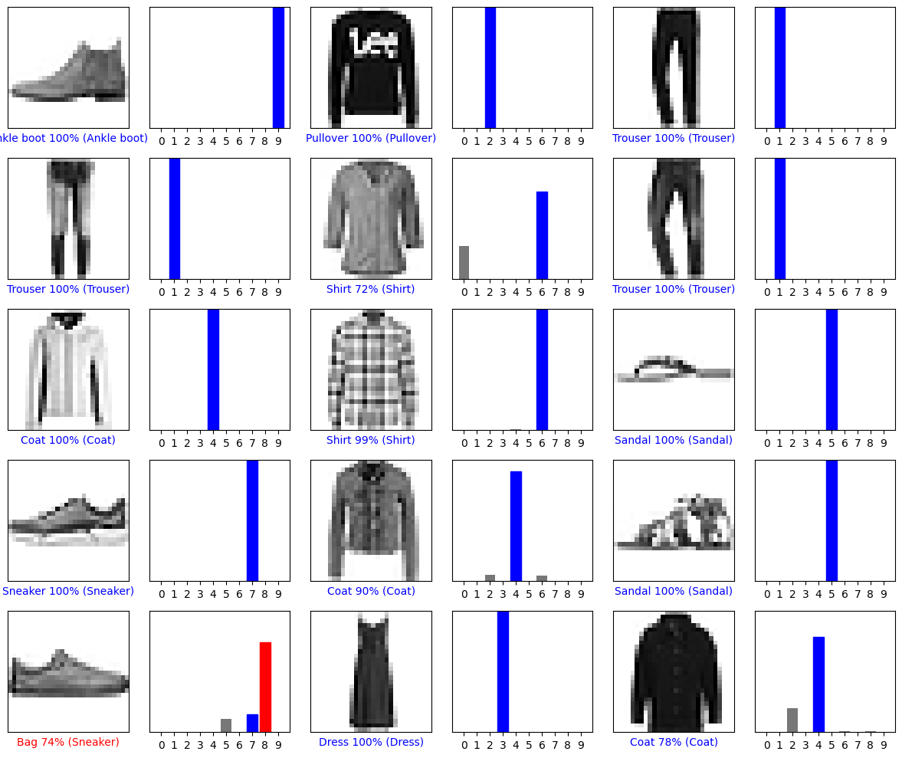
RESULTS

Slide 14
Conclusion:
In conclusion, this Project illustrates the effectiveness of TensorFlow for image classification tasks, using the Fashion MNIST dataset as a case study.Through the construction and training of neural network models, we've explored various methodologies to accurately categorize clothing items into predefined classes. The visualization of predictions further enhances our understanding of the model's behavior and confidence levels in classification tasksOverall

Slide 15
References
https://www.tensorflow.org/
pandas - Python Data Analysis Library (pydata.org)
NumPy –
https://storage.googleapis.com/tensorflow/tf-keras-datasets/train-labels-idx1-ubyte.gz

Slide 16
THANK YOU

